Slide 1
國立高雄科技大學(第一校區)電子工程系 系統晶片設計實習 Lab3 Vivado + Vivado SDK SoC Intrrupt
Teacher 陳朝烈 教授
Author 古仲安 莊旻哲 廖柏洵 林昱明 楊豐瑞

Slide 2
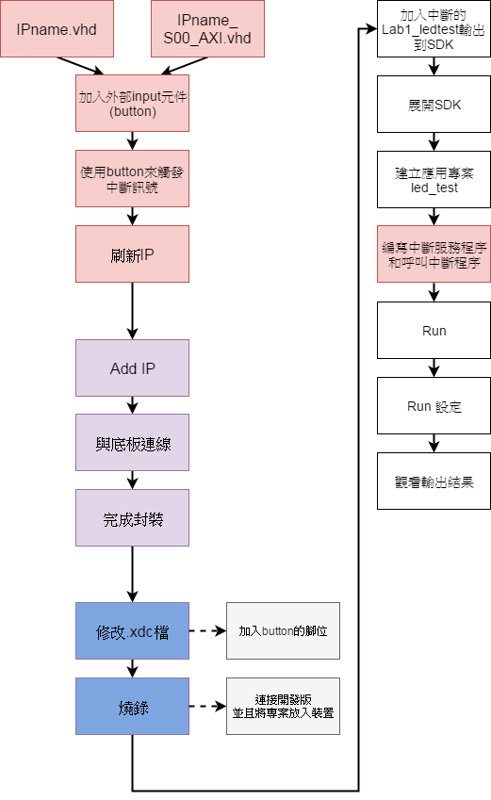

Slide 3
前導－在別的專案加入已有IP方法

Slide 4
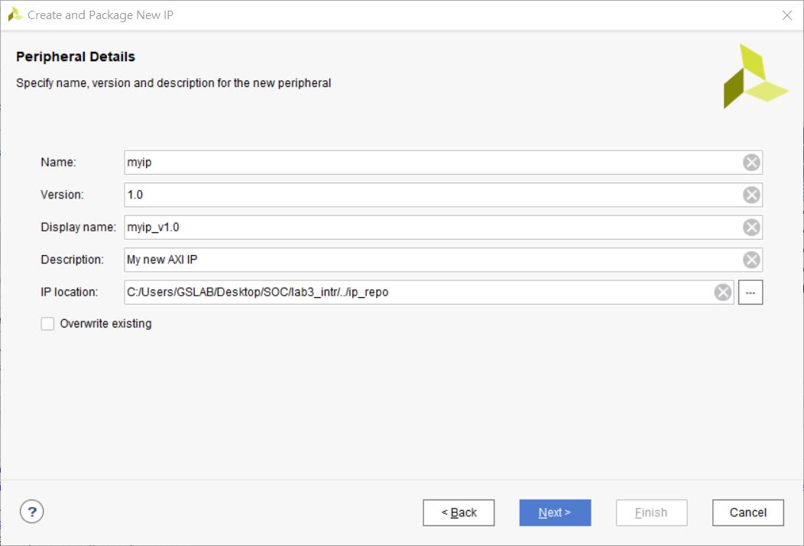
1.第一章在包IP時，可以選擇IP儲存位置

Slide 5
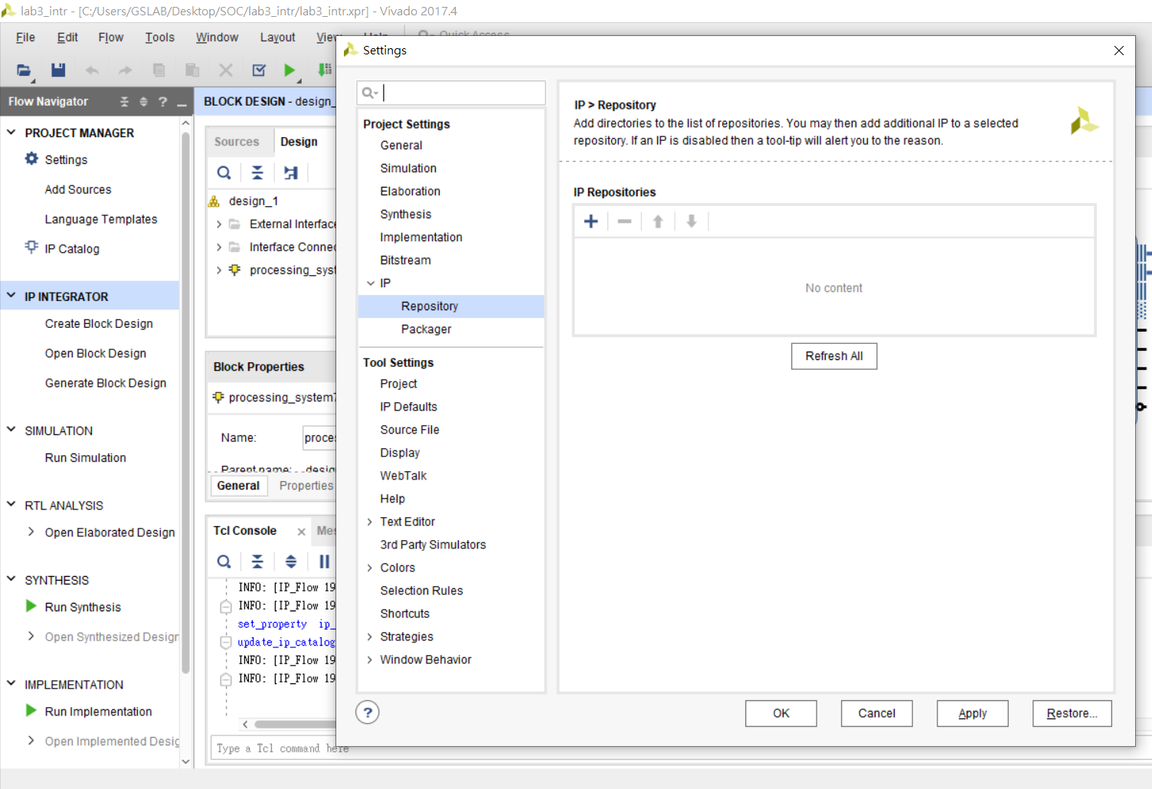
2.在新專案中左側選單->PROJECT MANAGER選擇Settings->IP->Repository
按+號選擇加入IP的資料夾
1
2 3

Slide 6
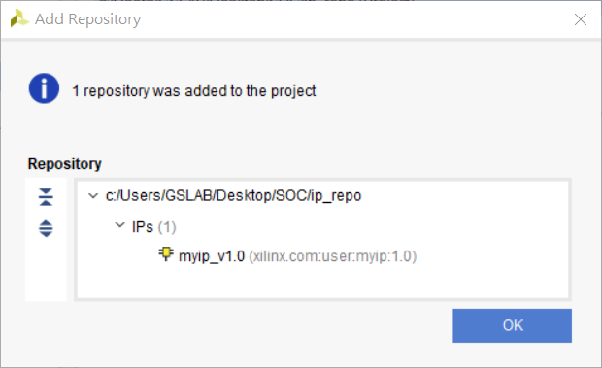
3.加入成功會顯示你的IP名稱，點OK後再點OK離開setting畫面
新增的IP就會出現在IP Catalog裡面

Slide 7
延續第一章與第二章練習

Slide 8
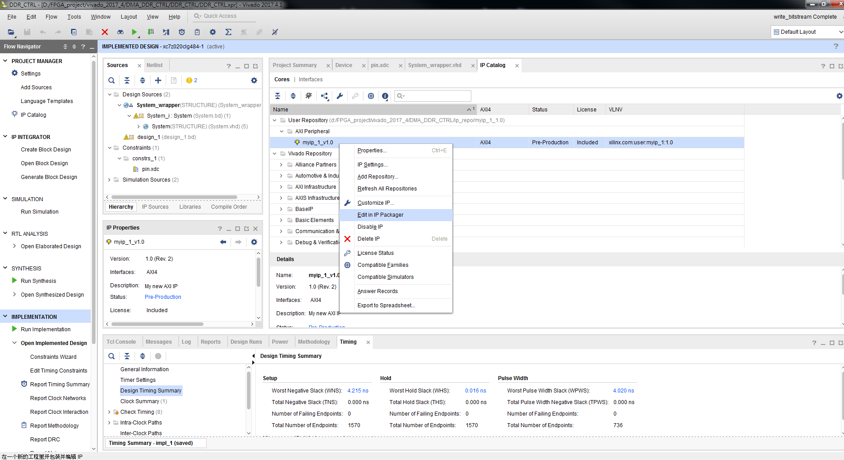
回到Vivado畫面
2
1
3

Slide 9
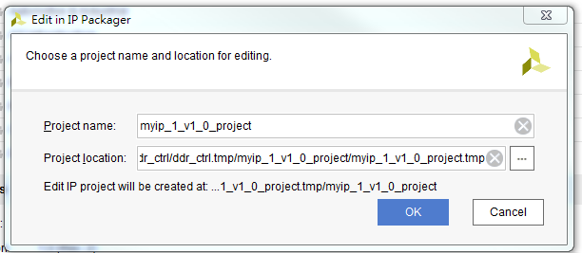

Slide 10
IPname.vhd

Slide 11
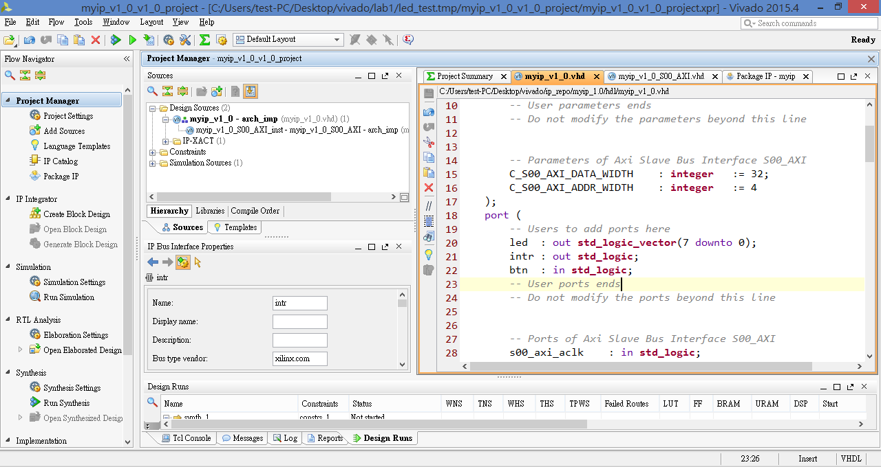

Slide 12
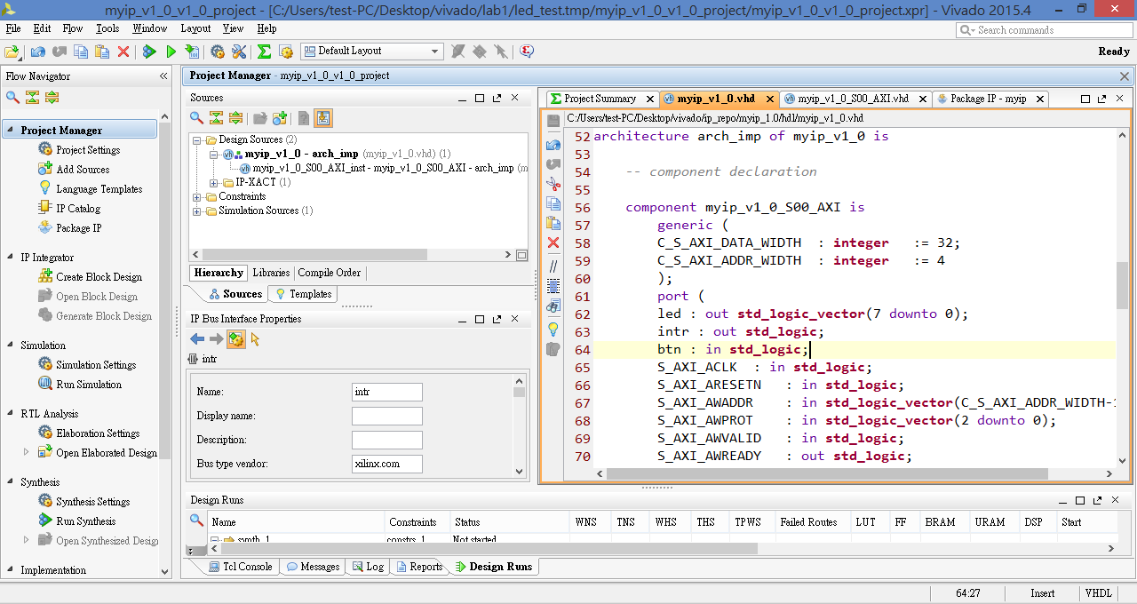

Slide 13
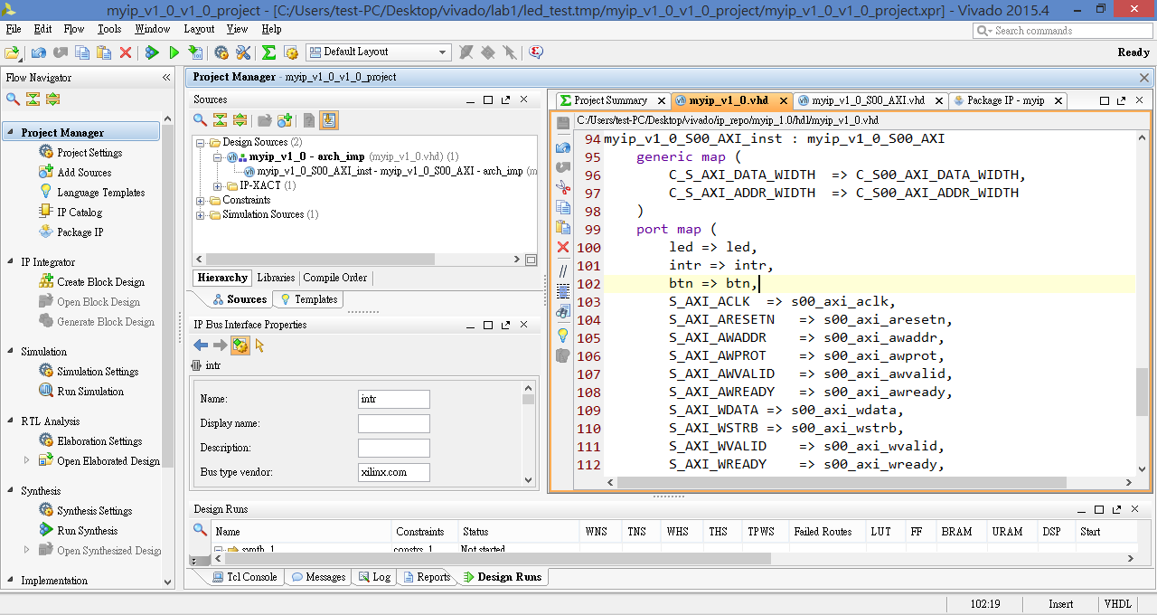

Slide 14
IPname_S00_AXI.vhd

Slide 15
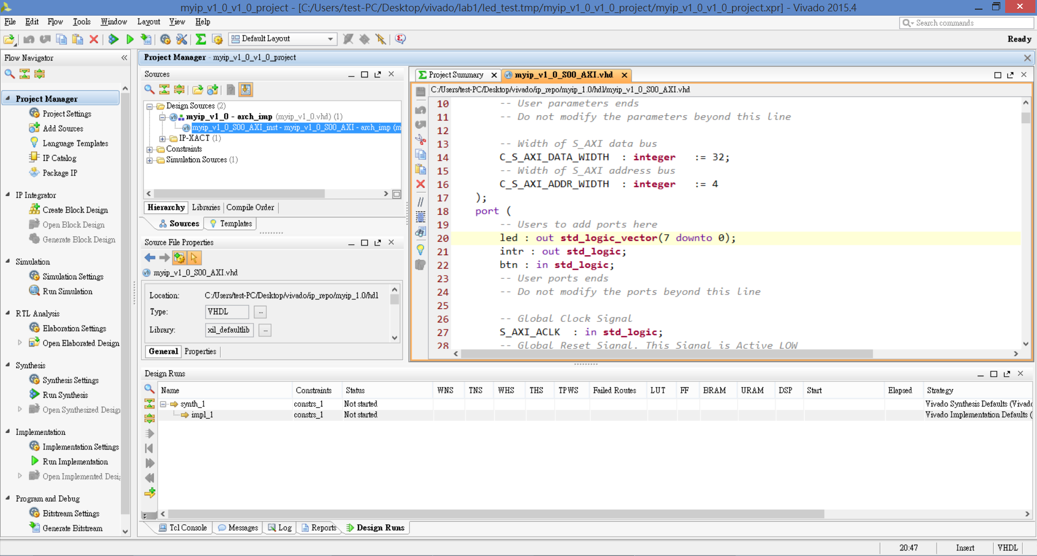

Slide 16
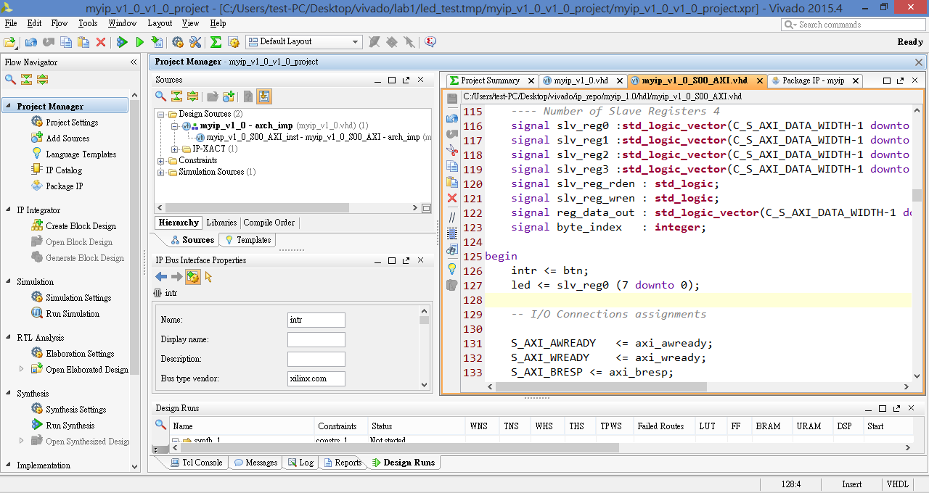
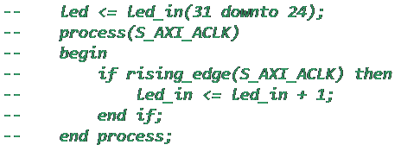
註解掉第一章練習所打的LED跑馬燈程式

Slide 17
設定IP之中斷訊號輸出腳位

Slide 18
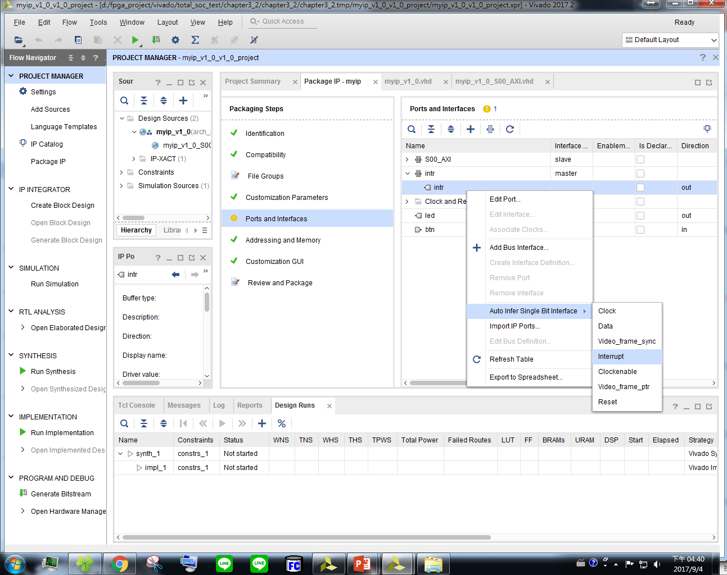
2
1
3
4

Slide 19
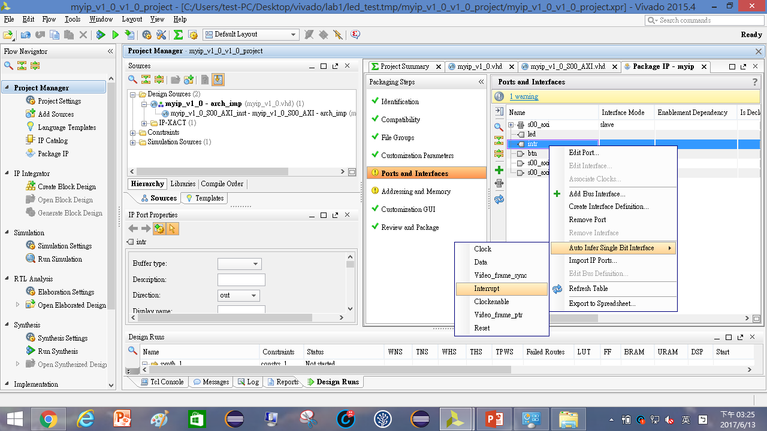
Vivado2015.4版本操作

Slide 20
刷新IP

Slide 21
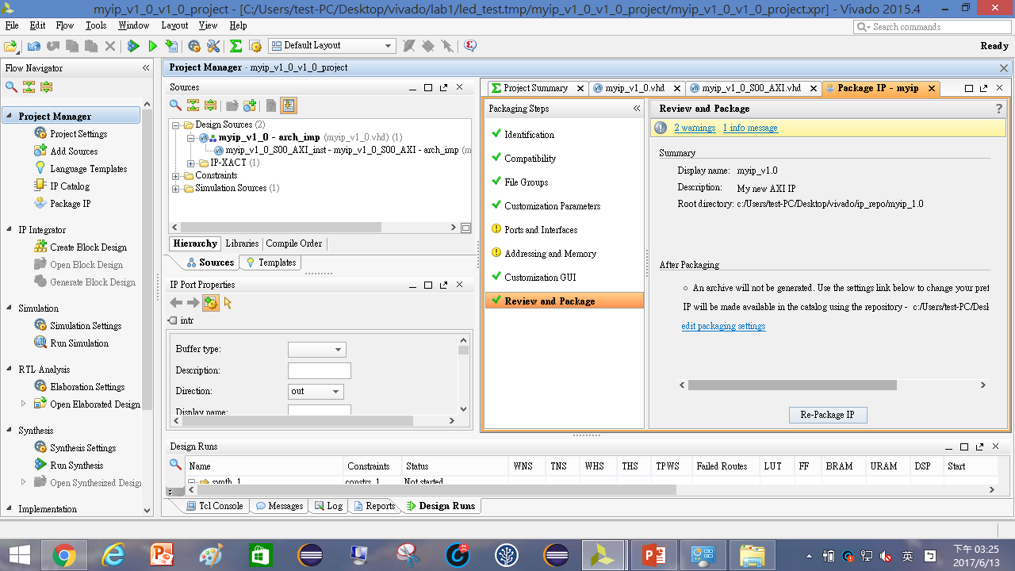

Slide 22
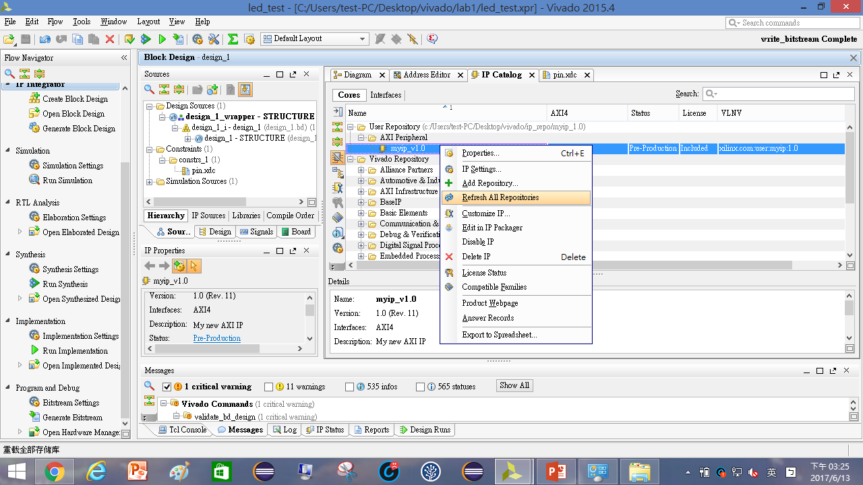

Slide 23
重新佈線

Slide 24
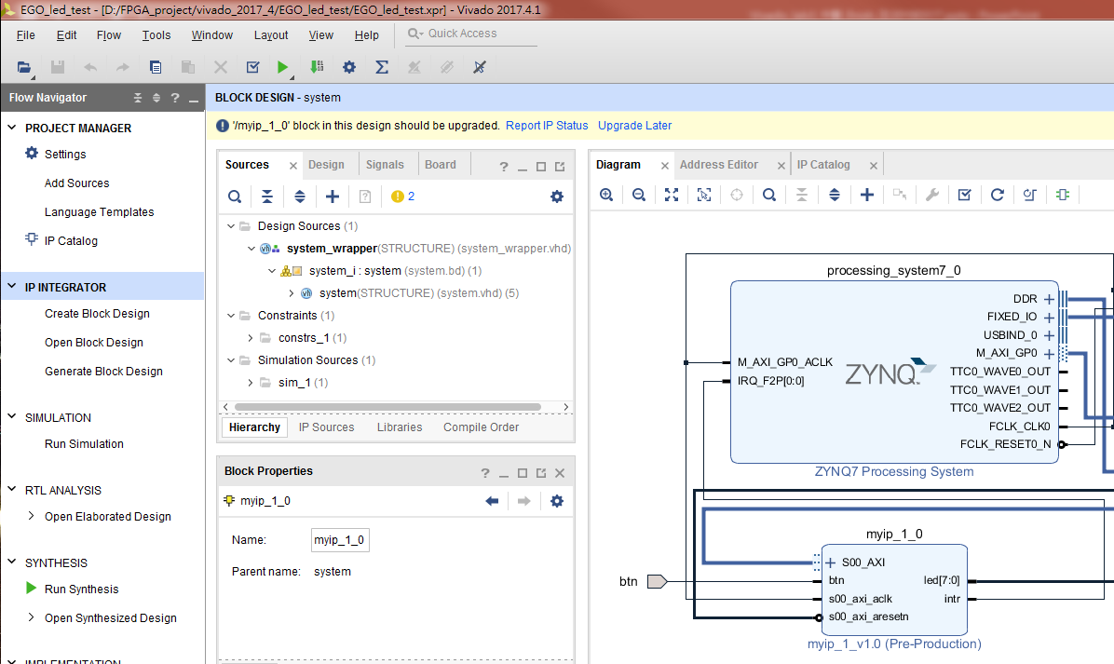
更新IP

Slide 25
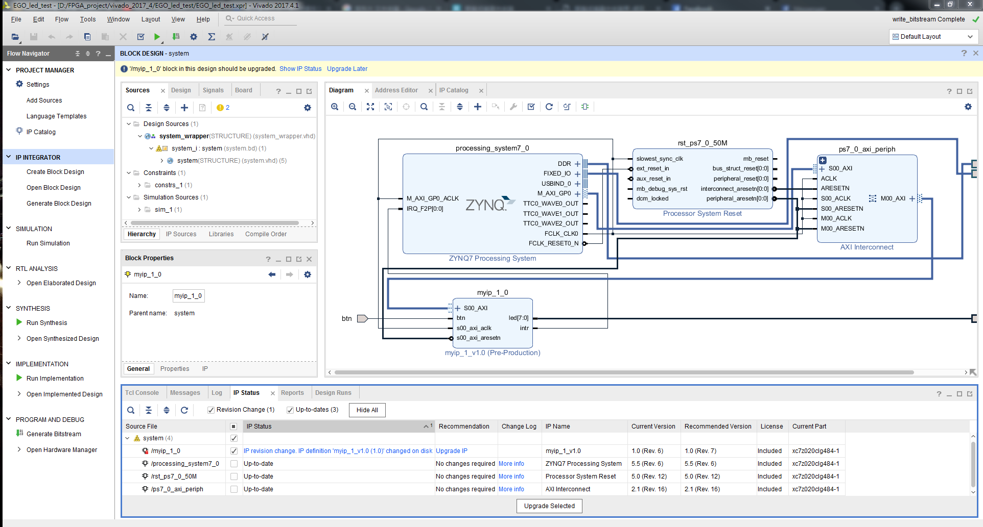
更新IP
1
2
3

Slide 26
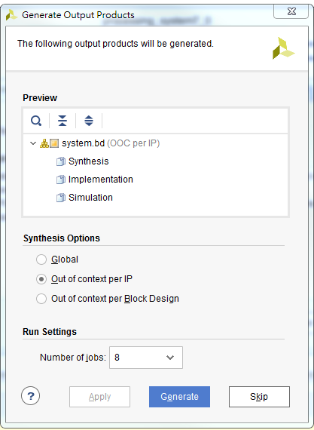
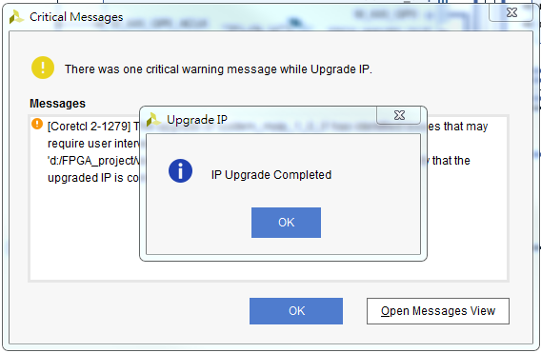
1
3
2

Slide 27
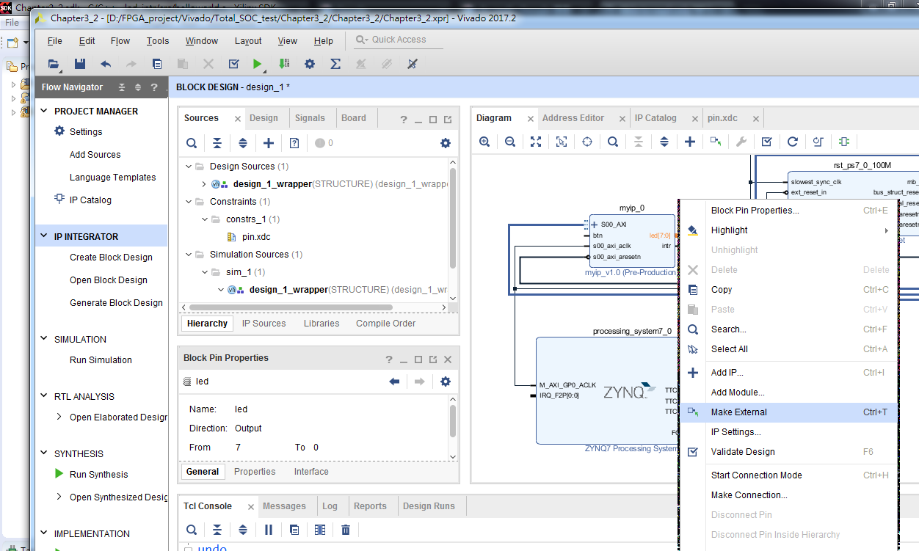
直接接線引出port
對接腳點右鍵

Slide 28
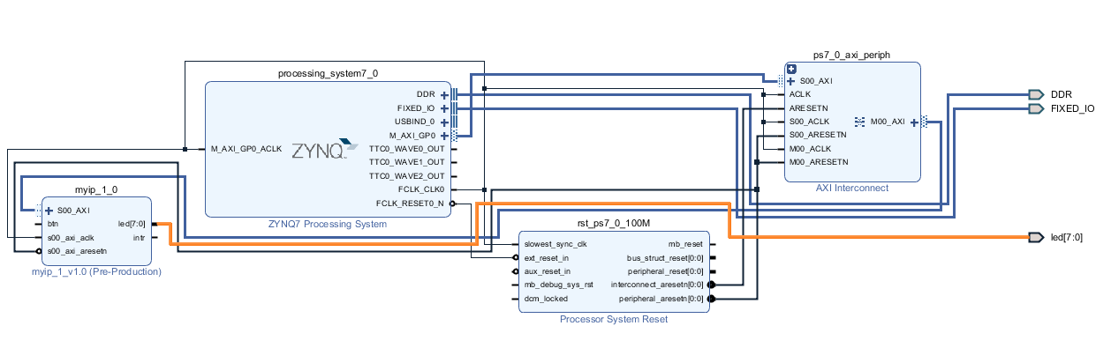
接腳名稱確認是 led

Slide 29
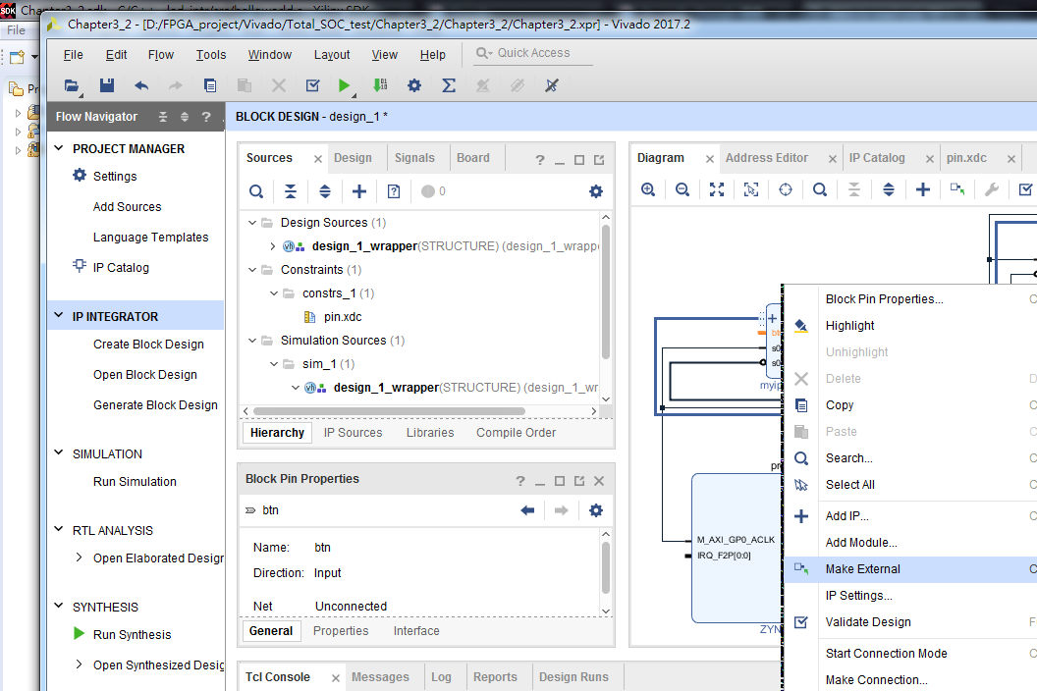
直接接線引出port
對接腳點右鍵

Slide 30
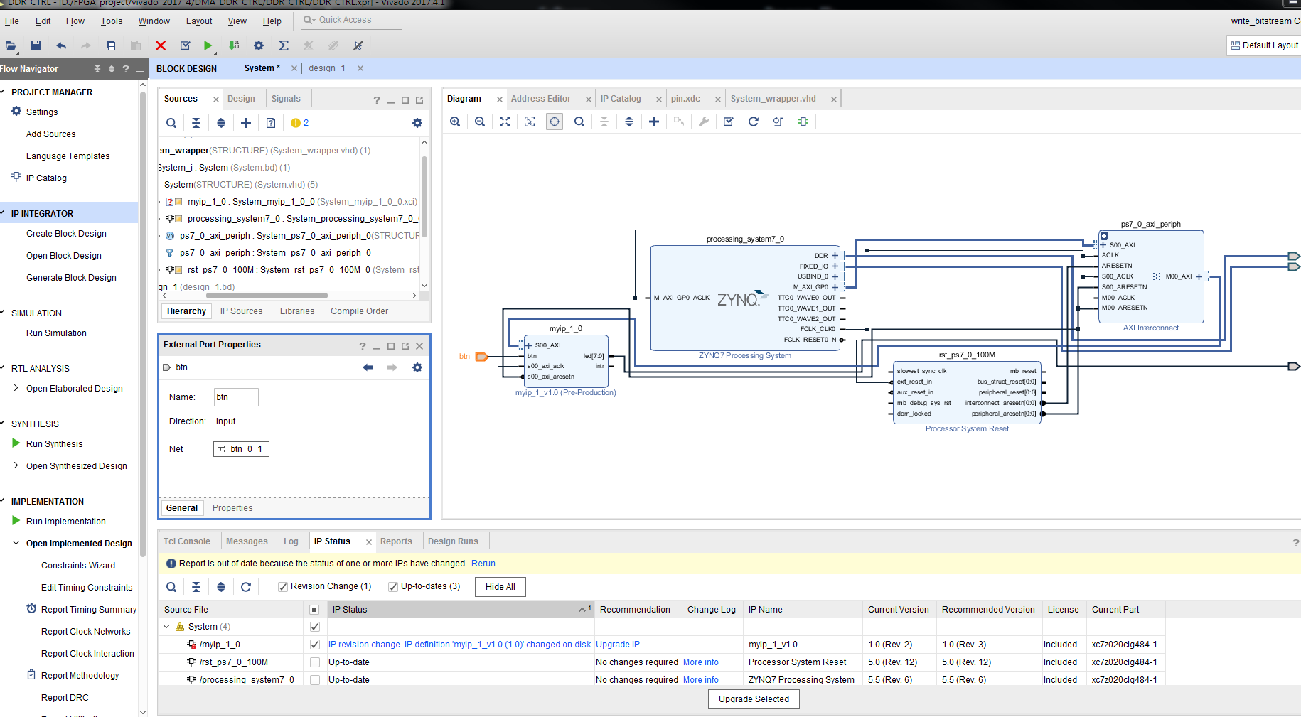
1
2
接腳名稱改成 btn

Slide 31
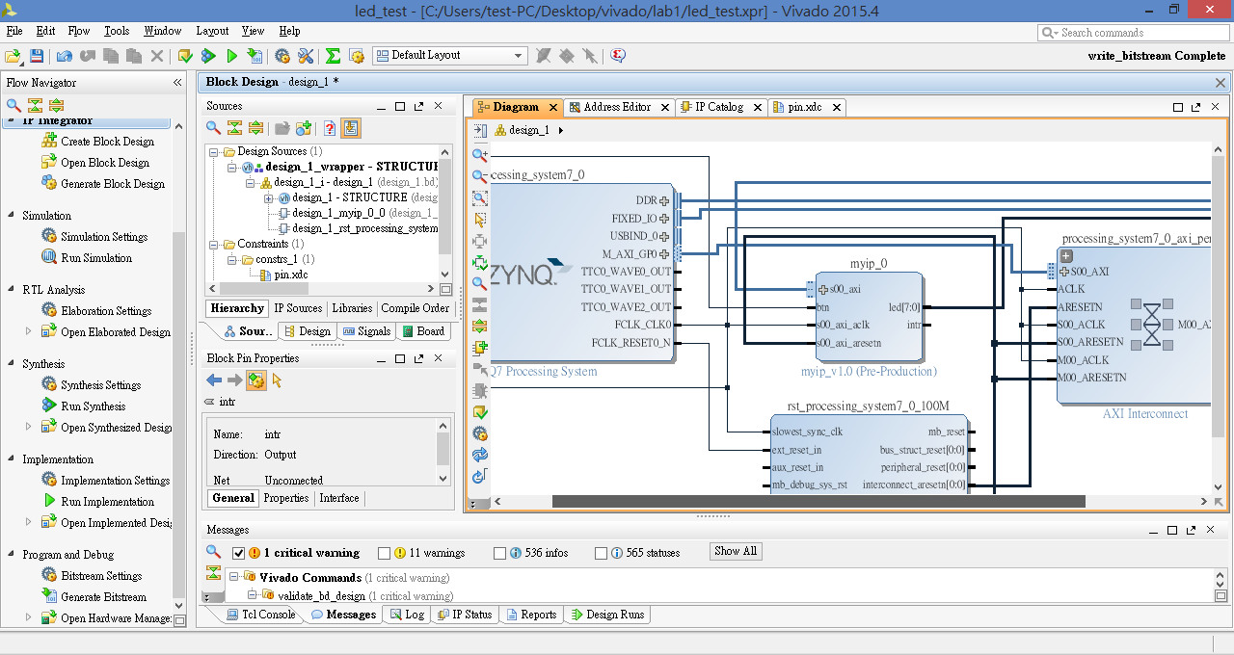
IP之間接線的樣子

Slide 32
定義底板中斷輸入腳位

Slide 33
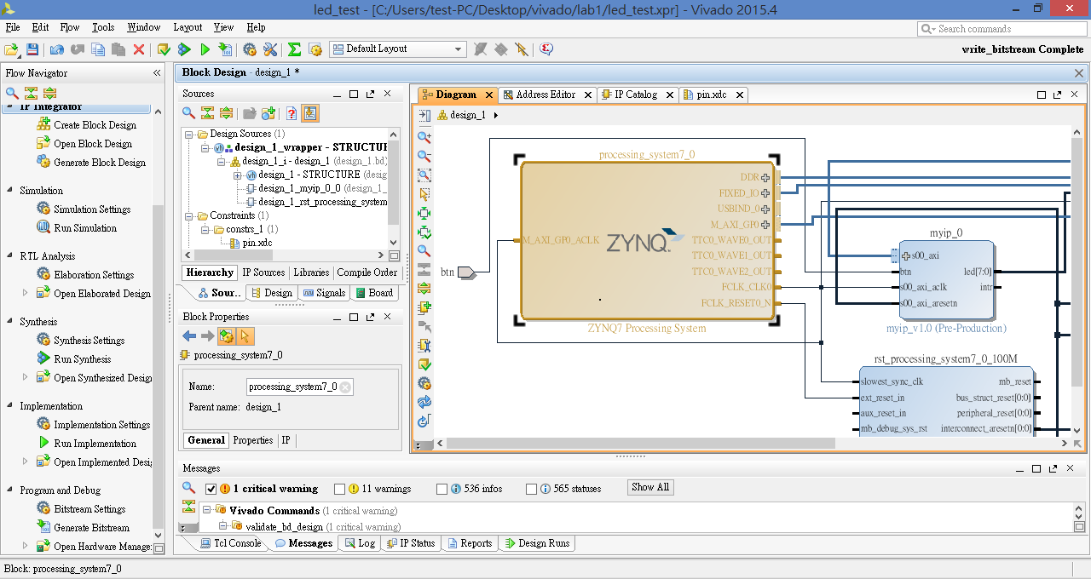
點兩下IP

Slide 34
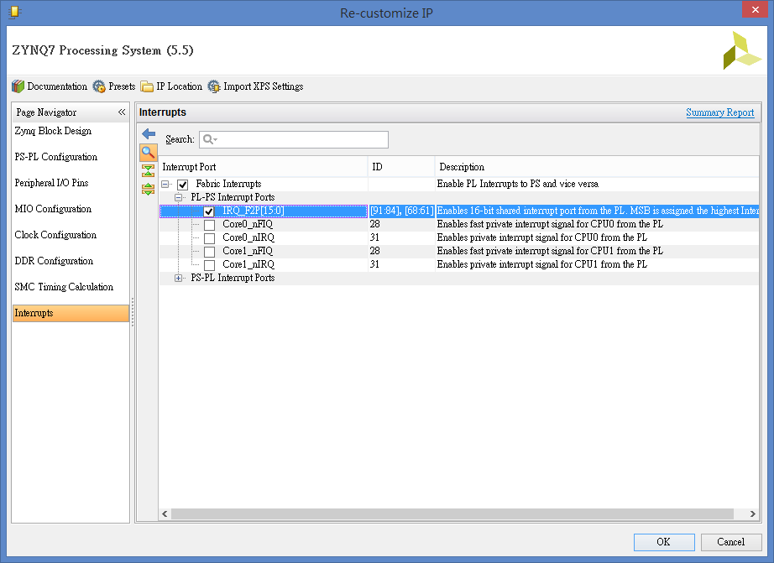
2
1
3

Slide 35
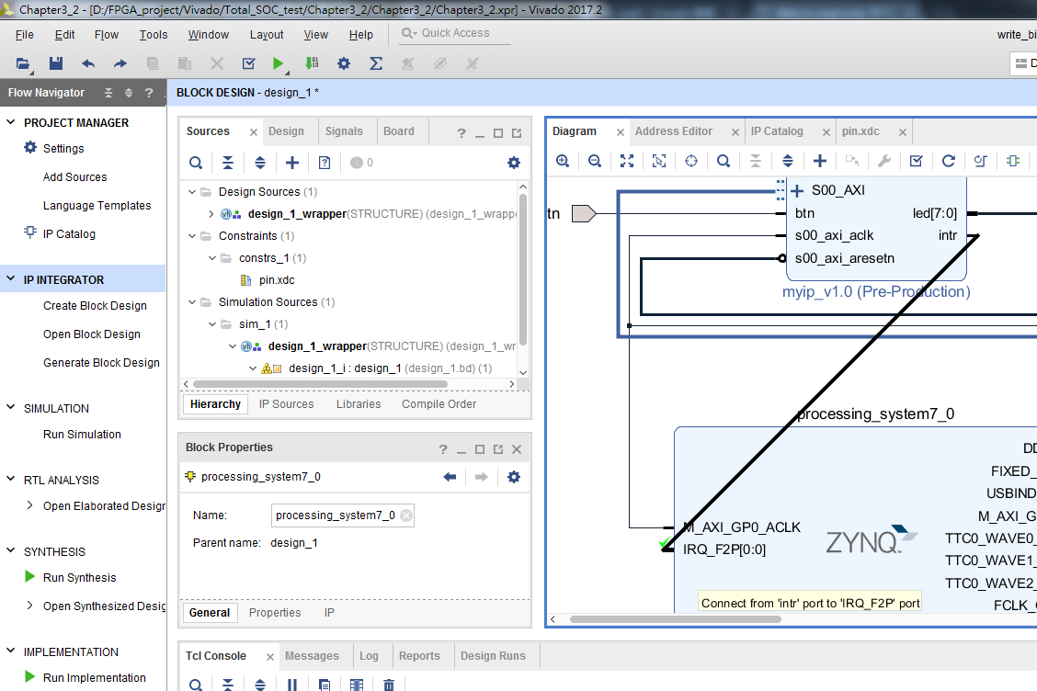
滑鼠點擊IP的port並拖曳連接INTERRUPT

Slide 36
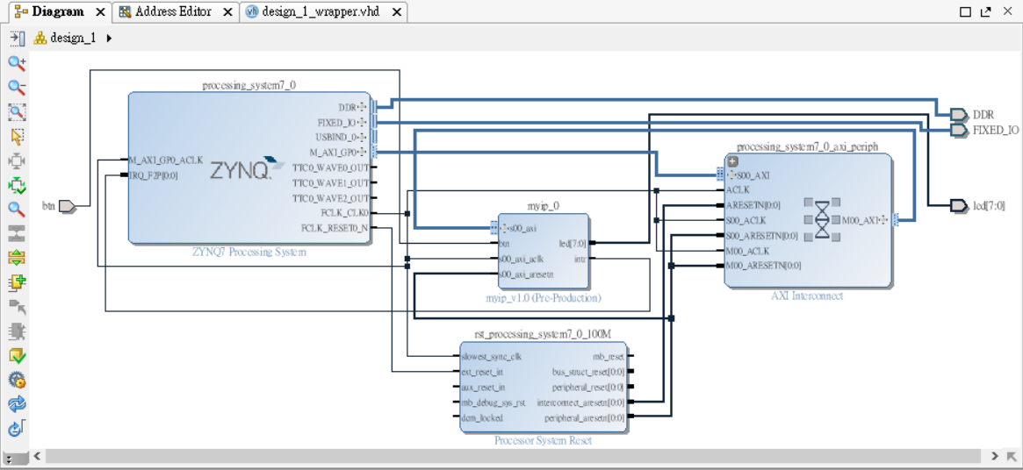
最後IP 接線情況

Slide 37
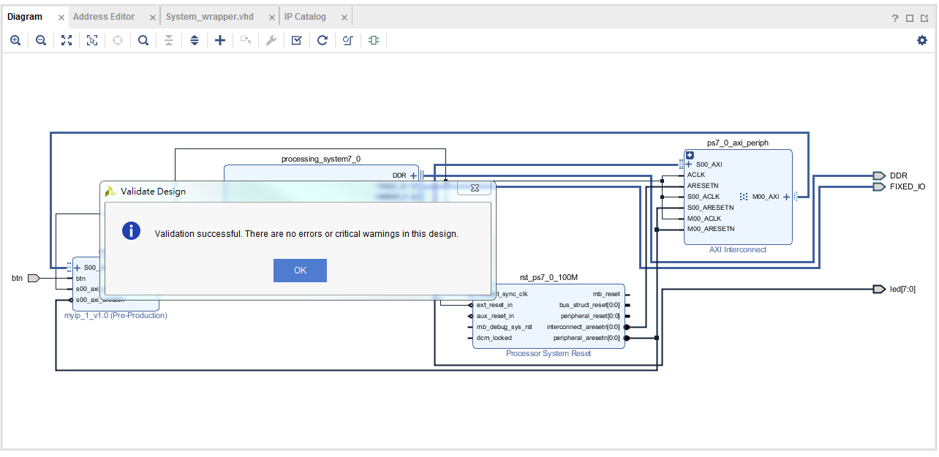
確認IP 接線正確
1
2

Slide 38
完成封裝

Slide 39
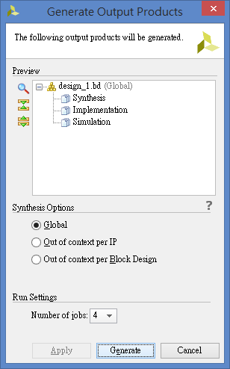
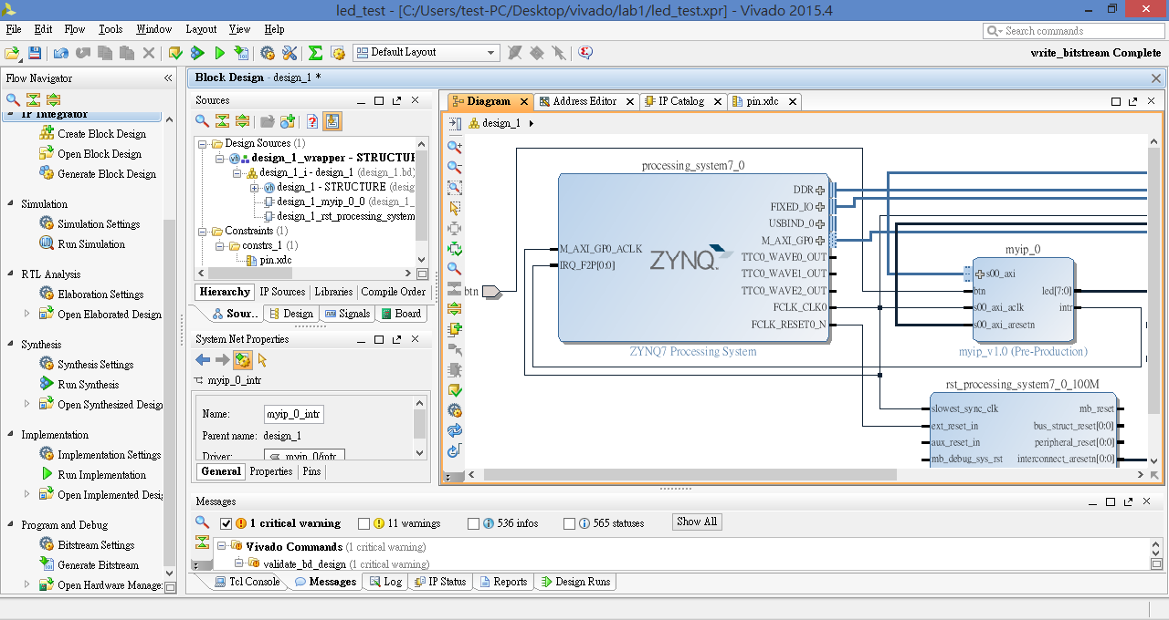
1
2

Slide 40
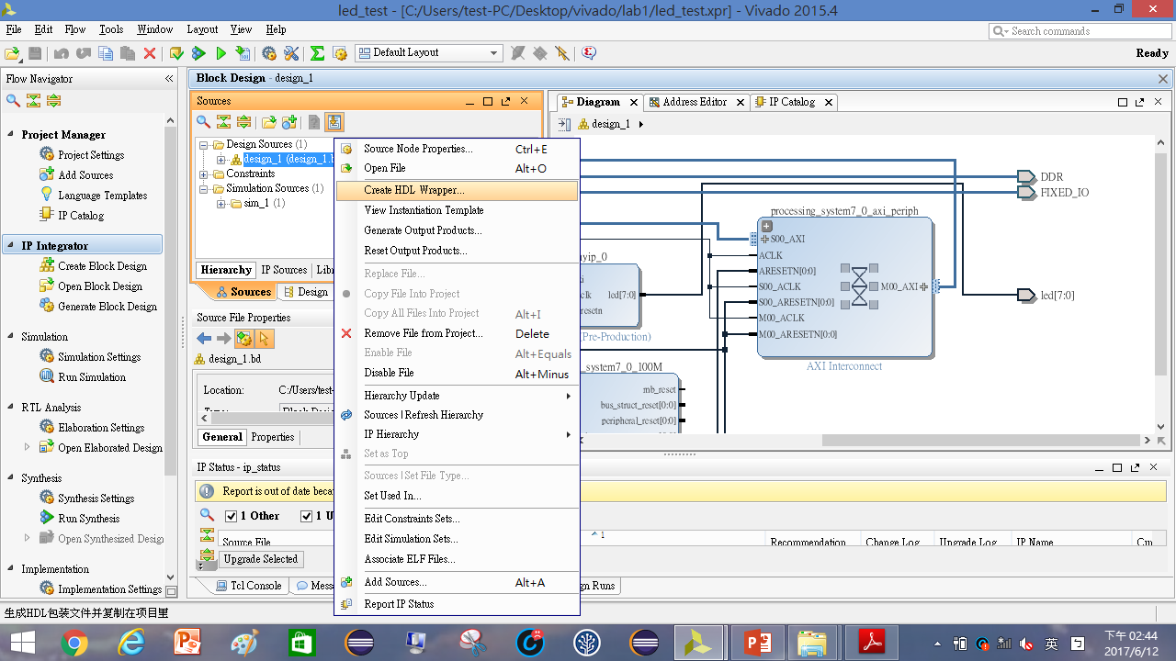
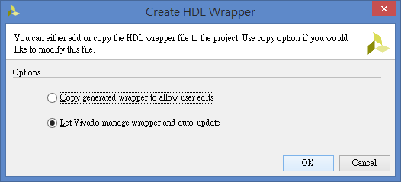
1
右鍵
2
3
3
4

Slide 41
新增/修改.xdc檔 (若是延續第一章練習則不用新增)

Slide 42
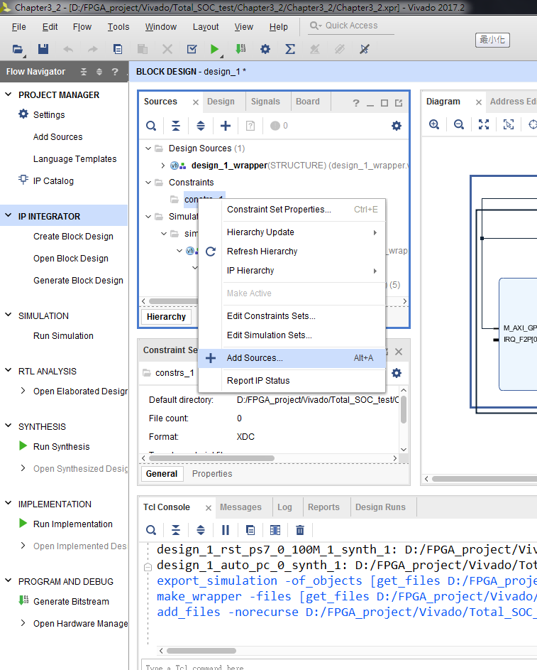
新增腳位檔

Slide 43
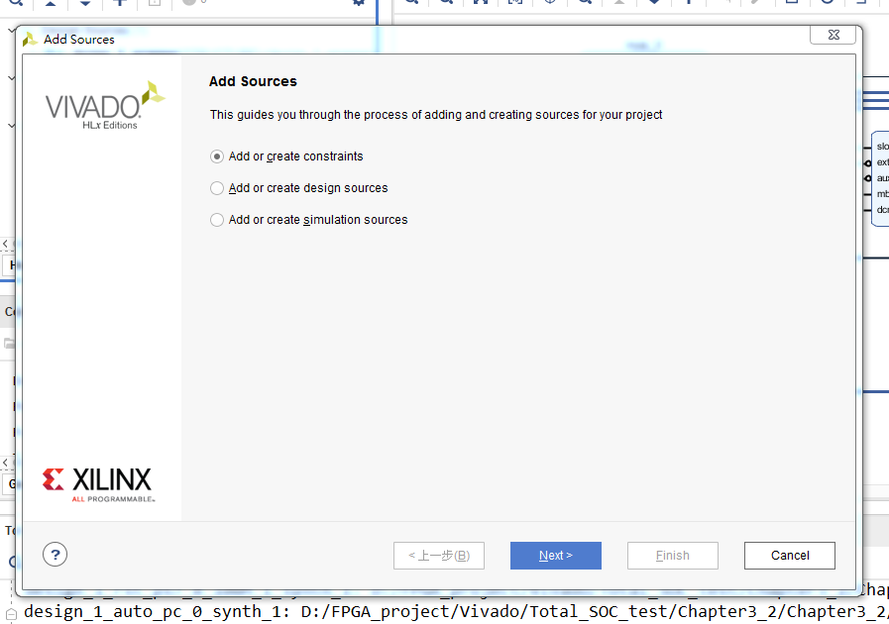
新增腳位檔

Slide 44
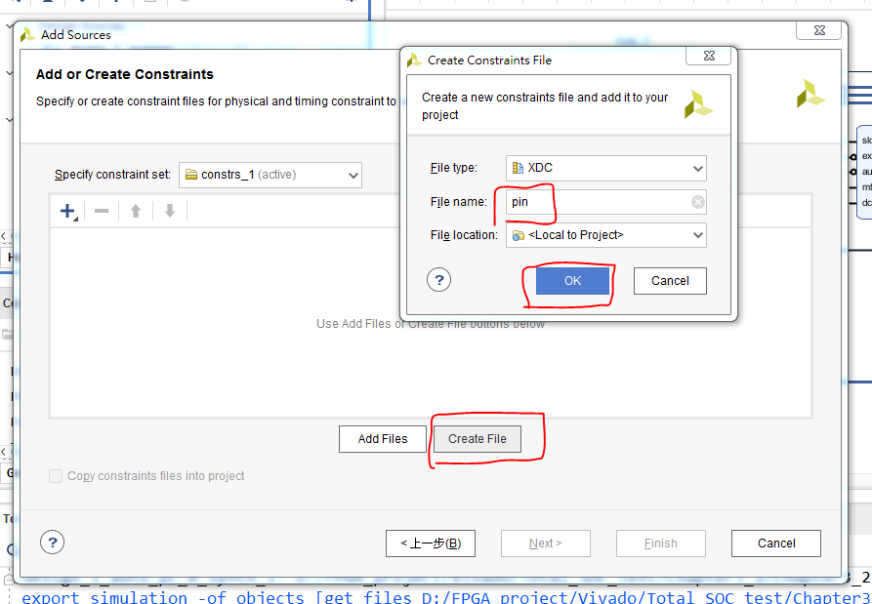
新增腳位檔

Slide 45
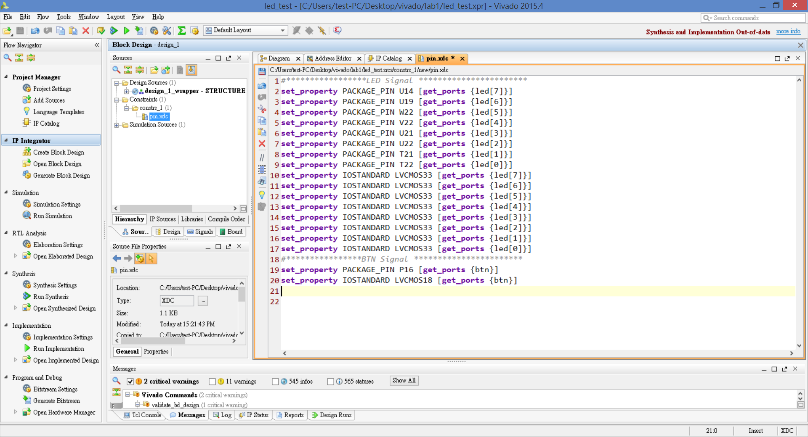

Slide 46
硬體接腳宣告
set_property PACKAGE_PIN U14 [get_ports {led[7]}]
set_property PACKAGE_PIN U19 [get_ports {led[6]}]
set_property PACKAGE_PIN W22 [get_ports {led[5]}]
set_property PACKAGE_PIN V22 [get_ports {led[4]}]
set_property PACKAGE_PIN U21 [get_ports {led[3]}]
set_property PACKAGE_PIN U22 [get_ports {led[2]}]
set_property PACKAGE_PIN T21 [get_ports {led[1]}]
set_property PACKAGE_PIN T22 [get_ports {led[0]}]
set_property IOSTANDARD LVCMOS33 [get_ports {led[7]}]
set_property IOSTANDARD LVCMOS33 [get_ports {led[6]}]
set_property IOSTANDARD LVCMOS33 [get_ports {led[5]}]
set_property IOSTANDARD LVCMOS33 [get_ports {led[4]}]
set_property IOSTANDARD LVCMOS33 [get_ports {led[3]}]
set_property IOSTANDARD LVCMOS33 [get_ports {led[2]}]
set_property IOSTANDARD LVCMOS33 [get_ports {led[1]}]
set_property IOSTANDARD LVCMOS33 [get_ports {led[0]}]
set_property PACKAGE_PIN P16 [get_ports {btn}]
set_property IOSTANDARD LVCMOS18 [get_ports {btn}]

Slide 47
進行編譯

Slide 48
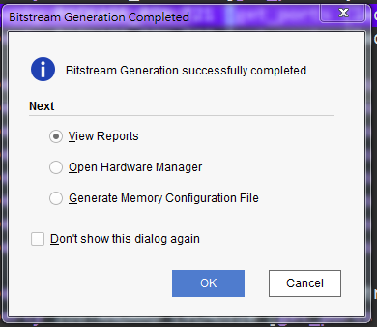

Slide 49
加入中斷的Lab1_ledtest輸出到SDK

Slide 50
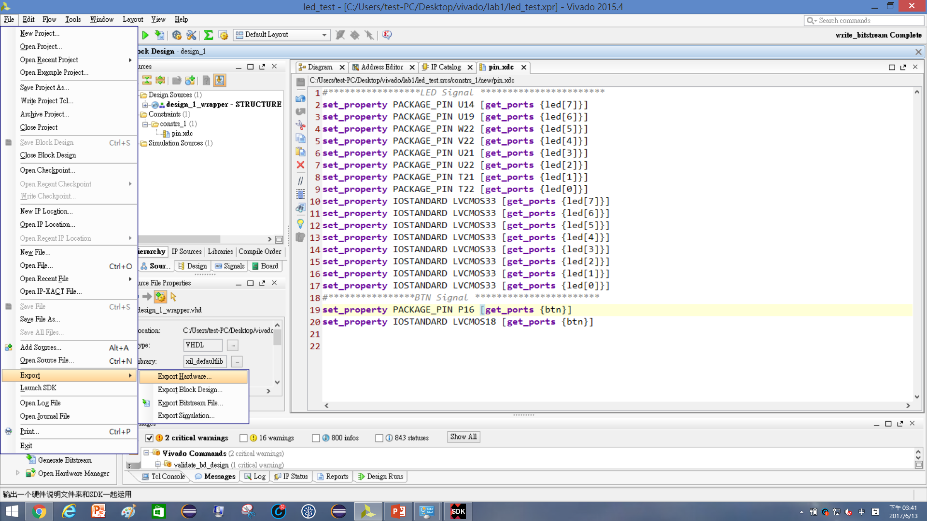
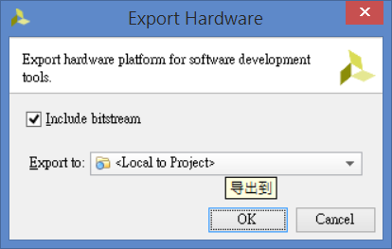
1
2
3
4

Slide 51
展開SDK (若延續第二章節實作下來的請先將SDK關掉)

Slide 52
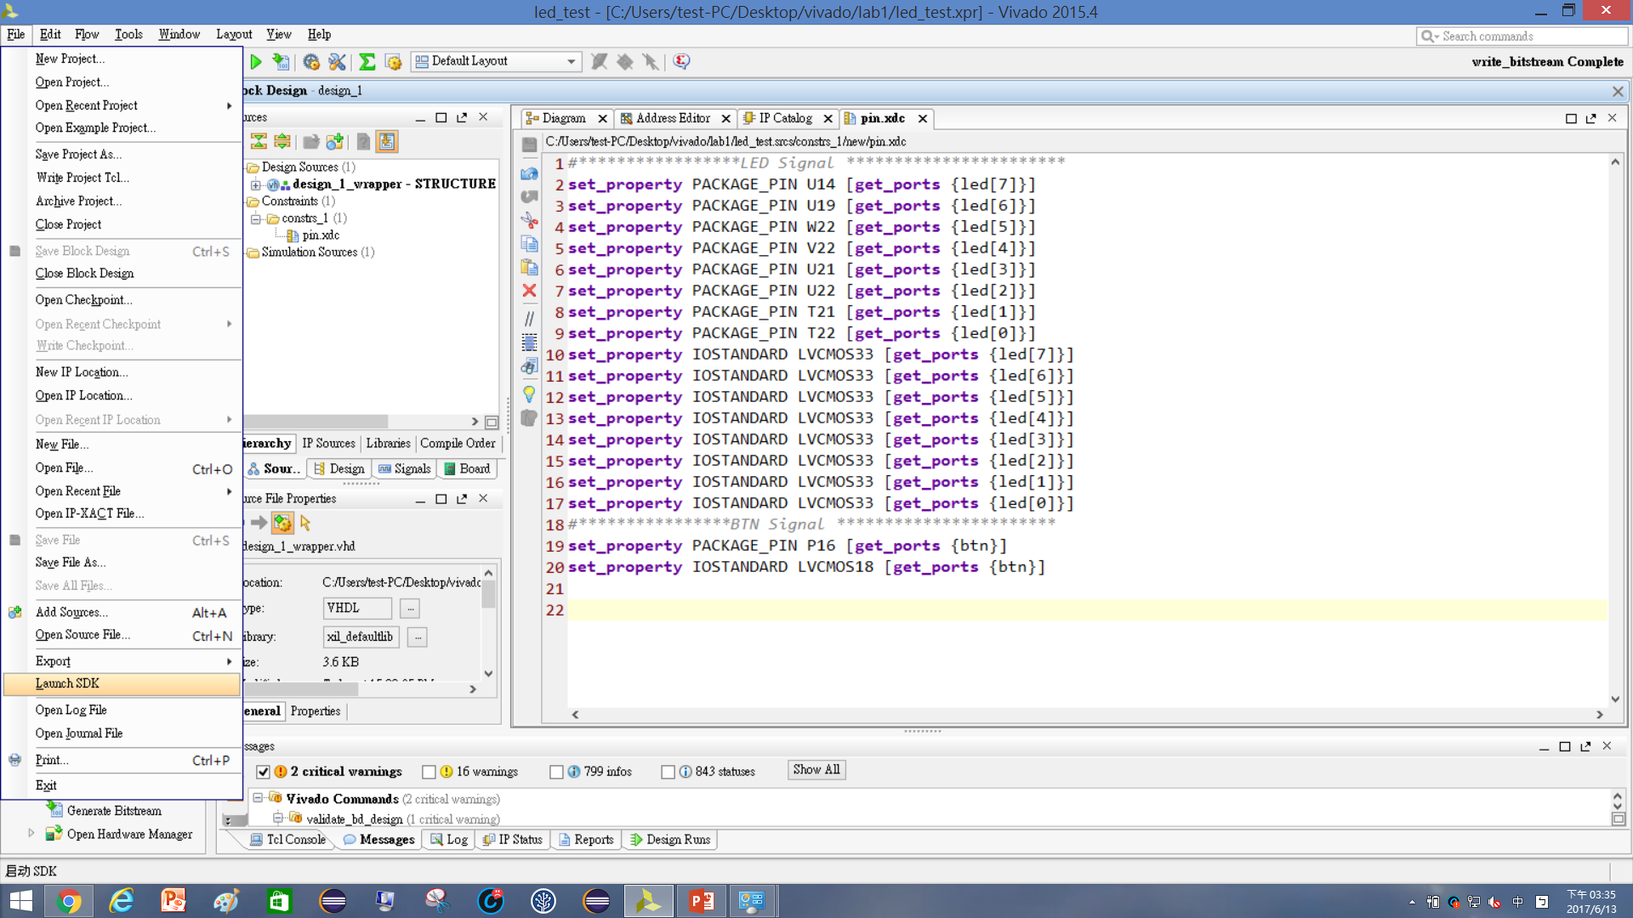

2
1

Slide 53
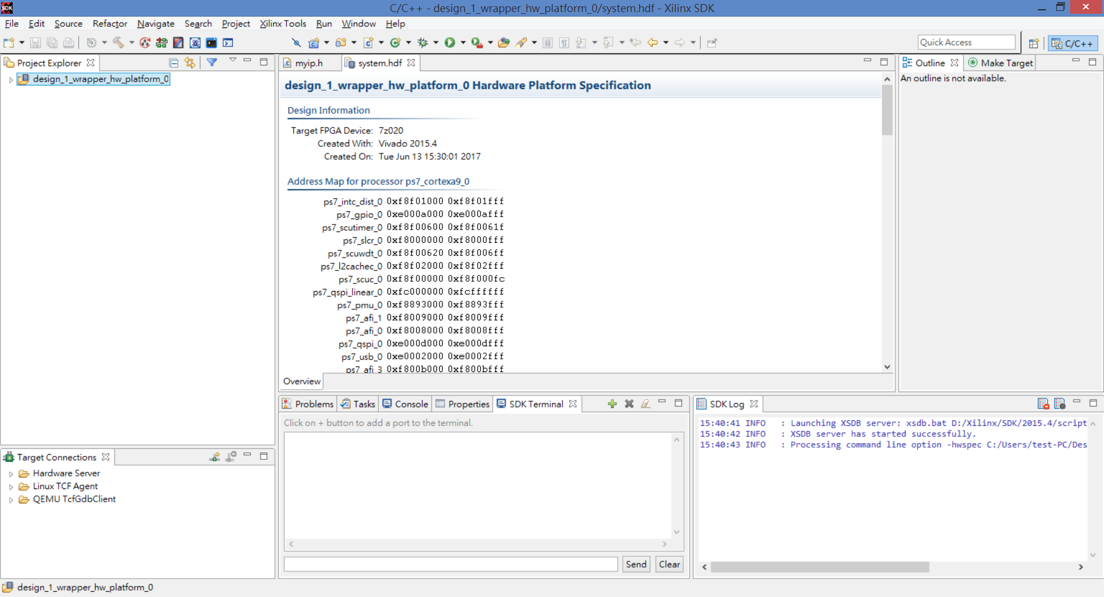

Slide 54
建立應用專案led_intr

Slide 55
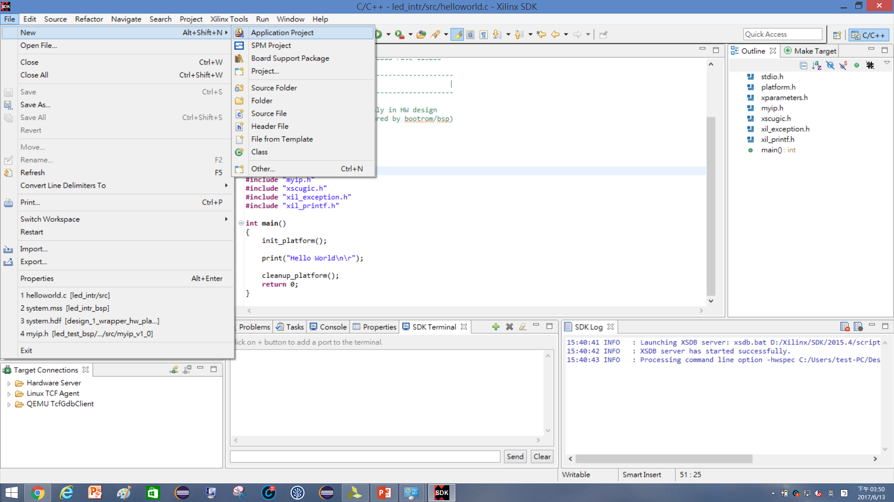
1
2

Slide 56
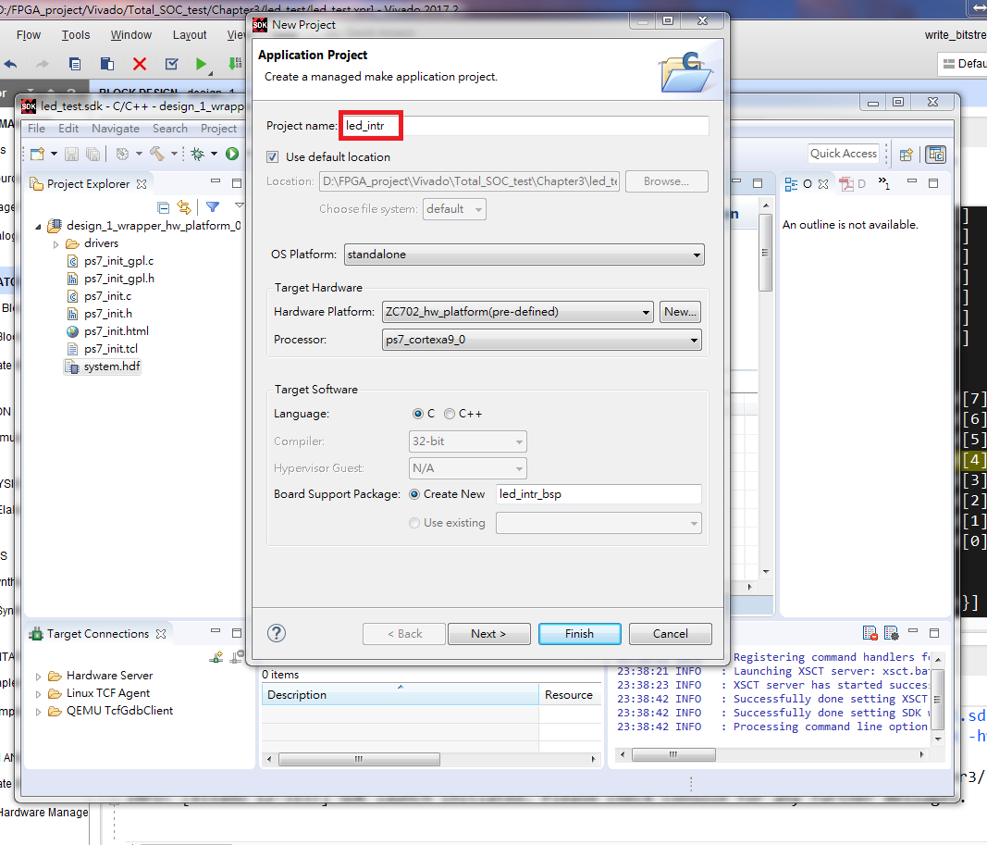

Slide 57
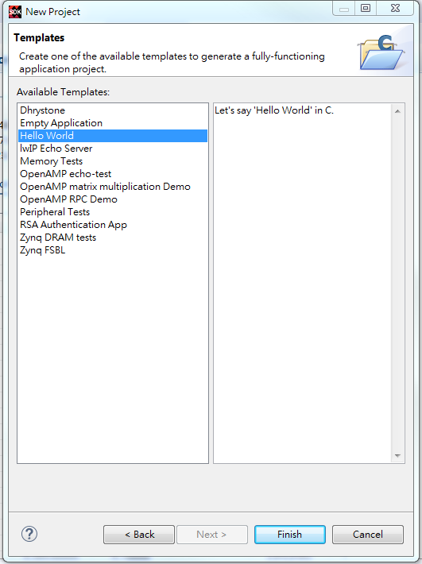

Slide 58
編寫中斷服務程式—原始碼

Slide 59
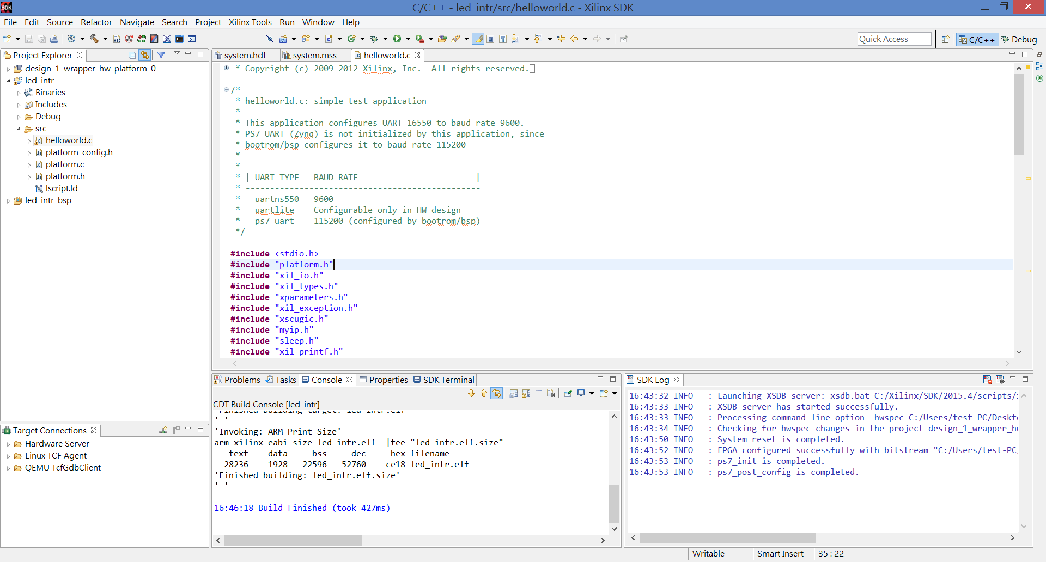
將下頁程式碼貼上到helloworld.c裡

Slide 60
/******************************************************************************** Copyright (C) 2009 - 2014 Xilinx, Inc. All rights reserved.** Permission is hereby granted, free of charge, to any person obtaining a copy* of this software and associated documentation files (the "Software"), to deal* in the Software without restriction, including without limitation the rights* to use, copy, modify, merge, publish, distribute, sublicense, and/or sell* copies of the Software, and to permit persons to whom the Software is* furnished to do so, subject to the following conditions:** The above copyright notice and this permission notice shall be included in* all copies or substantial portions of the Software.** Use of the Software is limited solely to applications:* (a) running on a Xilinx device, or* (b) that interact with a Xilinx device through a bus or interconnect.** THE SOFTWARE IS PROVIDED "AS IS", WITHOUT WARRANTY OF ANY KIND, EXPRESS OR* IMPLIED, INCLUDING BUT NOT LIMITED TO THE WARRANTIES OF MERCHANTABILITY,* FITNESS FOR A PARTICULAR PURPOSE AND NONINFRINGEMENT. IN NO EVENT SHALL* XILINX BE LIABLE FOR ANY CLAIM, DAMAGES OR OTHER LIABILITY,* WHETHER IN AN ACTION OF CONTRACT, TORT OR OTHERWISE, ARISING FROM, OUT OF* OR IN CONNECTION WITH THE SOFTWARE OR THE USE OR OTHER DEALINGS IN THE* SOFTWARE.** Except as contained in this notice, the name of the Xilinx shall not be used* in advertising or otherwise to promote the sale, use or other dealings in* this Software without prior written authorization from Xilinx.*******************************************************************************//* * helloworld.c: simple test application * * This application configures UART 16550 to baud rate 9600. * PS7 UART (Zynq) is not initialized by this application, since * bootrom/bsp configures it to baud rate 115200 * * ------------------------------------------------ * | UART TYPE BAUD RATE | * ------------------------------------------------ * uartns550 9600 * uartlite Configurable only in HW design * ps7_uart 115200 (configured by bootrom/bsp) */
#include <stdio.h>
#include "platform.h"
#include "xil_io.h"
#include "xil_types.h"
#include "xparameters.h"
#include "xil_exception.h"
#include "xscugic.h"
#include "myip.h"
#include "sleep.h"
#include “xil_printf.h“ //若會出錯則此行註解掉
XScuGic InterruptController; /* Instance of the Interrupt Controller */
static XScuGic_Config *GicConfig;/* The configuration parameters of the controller */
int XPAR_FABRIC_MYIP_0_INTR_INTR = 61;//######interrupt number####################(vivado2017.4此行可註解)
void INTERRUPT_Handler0(void *baseaddr_p){
int i;
print("Push Button was pressed\r\n");
//xil_printf("Push Button was pressed\r\n");
for(i=0;i<2;i++){
MYIP_mWriteReg(0x43C00000, MYIP_S00_AXI_SLV_REG0_OFFSET, 0xf0);
usleep(500000);
MYIP_mWriteReg(0x43C00000, MYIP_S00_AXI_SLV_REG0_OFFSET, 0x0f);
usleep(500000);
}
}
int ScuGicInterrupt_Init(void)
{
int Status;
/*
* Initialize the interrupt controller driver so that it is ready to
* use.
* */
Xil_ExceptionInit();
GicConfig = XScuGic_LookupConfig(XPAR_PS7_SCUGIC_0_DEVICE_ID);
if (NULL == GicConfig) {
return XST_FAILURE;
}
Status = XScuGic_CfgInitialize(&InterruptController, GicConfig,
GicConfig->CpuBaseAddress);
if (Status != XST_SUCCESS) {
return XST_FAILURE;
}
1
2

Slide 61
/*
* Setup the Interrupt System
* */
/*
* Connect the interrupt controller interrupt handler to the hardware
* interrupt handling logic in the ARM processor.
*/
Xil_ExceptionRegisterHandler(XIL_EXCEPTION_ID_IRQ_INT,
(Xil_ExceptionHandler) XScuGic_InterruptHandler,
(void *) &InterruptController);
/*
* Connect a device driver handler that will be called when an
* interrupt for the device occurs, the device driver handler performs
* the specific interrupt processing for the device
* since the xparameters.h file doesnt detect the external interrupts, we have to manually
* use the IRQ_F2P port numbers ; 91, 90, ect..
*/
Status = XScuGic_Connect(&InterruptController,XPAR_FABRIC_MYIP_0_INTR_INTR,
(Xil_ExceptionHandler)INTERRUPT_Handler0,
(void *)&InterruptController);
XScuGic_Enable(&InterruptController, XPAR_FABRIC_MYIP_0_INTR_INTR);
/*
* Enable interrupts in the ARM
*/
Xil_ExceptionEnable();
/*
* Set interrupts PriorityTriggerType
*/
XScuGic_SetPriorityTriggerType(&InterruptController, XPAR_FABRIC_MYIP_0_INTR_INTR,
0xa0, 3);
if (Status != XST_SUCCESS)
return XST_FAILURE;
}
int main()
{
int xstatus;
// Interrupt Test
xstatus = ScuGicInterrupt_Init();
if (xstatus != XST_SUCCESS)
return XST_FAILURE;
// Wait For interrupt;
print("Wait for the interrupt to trigger \r\n");
print("########################################\r\n");
print(" \r\n");
int i=0;
while(1){
for(i=0;i<=255;i++){
MYIP_mWriteReg(0x43C00000, MYIP_S00_AXI_SLV_REG0_OFFSET, i);
printf("i = %d \r\n",i);
sleep(1);
}
}
return 0;
}
3
4

Slide 62
編寫中斷服務程式—offset address

Slide 63
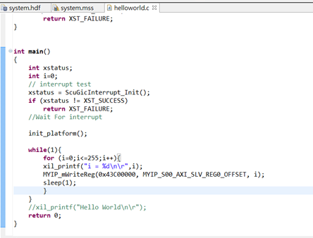
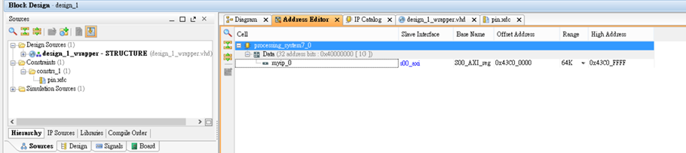
觀看IP的中斷腳位

Slide 64
Run

Slide 65
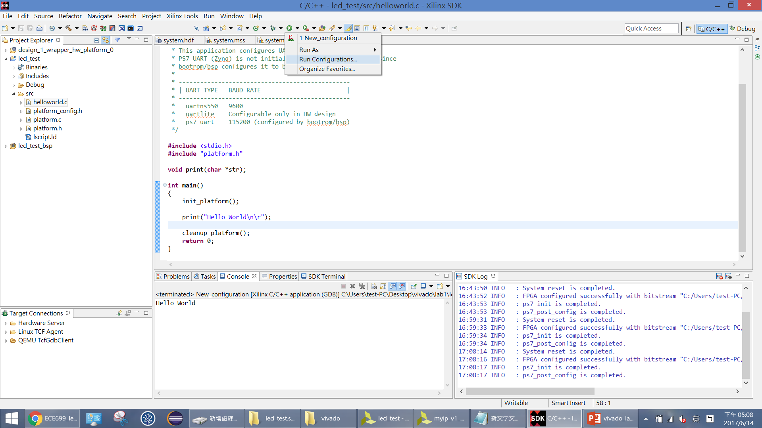
必須預先選取才能Run對程式
2
1

Slide 66
Run設定

Slide 67

先將就的configuration刪除

Slide 68

快速點兩下產生
下面的New_configuration項目

Slide 69

2
1
3

Slide 70

Bit檔路徑在 專案資料夾\Project檔名.runs \ impl_1
2
1
3

Slide 71

加入.bit檔的話在Run時會再對FPGA進行燒入
或者若未加入.bit檔，可在Run CPU後再進行燒入
1
2

Slide 72


Slide 73


Slide 74

在SoC開發板的UART接到電腦上電後，自行到裝置管理員看UART COM port

Slide 75

必須將在第一章開起的Hardware Manage關閉才可進行下一步

Slide 76
1
2

Slide 77
觀看輸出結果

Slide 78

當按下板子上方向按鍵的中間按鈕就會出現 Push Button was pressed訊息
0

Slide 79

Demo情況

Slide 80
附錄 – 程式碼說明

Slide 81

開起SDK觀察程式

Slide 82

觀察ipName.h
此IP硬體設定4個暫存器
此處define暫存器的偏移位址
對暫存器寫值
對暫存器讀值
觀察xparameters.h
Xilinx內建的一些參數define
##根據版本不一樣有時會有不同內容or值

